Slide 1
Oasis Elementary SAC Meeting
September 12, 2018

Slide 2
17-18 School Grade
ELA Achievement | ELA Learning Gains | ELA Learning Gains of the Lowest 25% | Math Achievement | Math Learning Gains | Math Learning Gains of the Lowest 25% | Science Achievement | Total Points
75 | 63 | 62 | 79 | 67 | 58 | 68 | 472

Slide 3
Math
Year | Achievement | LG | L25
2017-2018 | 79 | 67 | 58
2016-2017 | 65 | 49 | 32
2015-2016 | 65 | 47 | 46
2014-2015 | 69

Slide 4
English Language Arts
Year | Achievement | LG | L25
2017-2018 | 75 | 63 | 62
2016-2017 | 72 | 60 | 60
2015-2016 | 72 | 51 | 51
2014-2015 | 72

Slide 5
Science
Year | Achievement
2017-2018 | 68
2016-2017 | 66
2015-2016 | 67
2014-2015 | 71

Slide 6
2018-2019 Goals
Science
Increase Proficiency by 2%
From 68 to 70
ELA
Increase Proficiency by 2%
From 75 to 77
Increase Learning Gains by 2%
From 63 to 65
Increase L25 Learning Gains by 3%
From 39-42

Slide 7
2018-2019 Goals
Math
Increase Proficiency by 2%
From 79 to 81
Increase Learning Gains by 2%
From 67 to 69
Increase L25 Learning Gains by 3%
From 68 to 71

Slide 8
STAR/FSA ELA Buckets

Slide 9
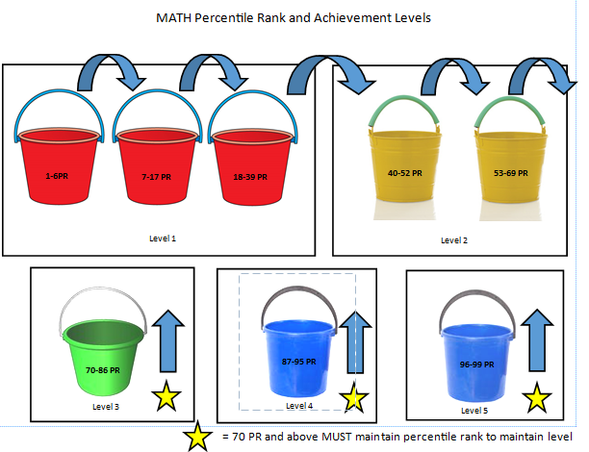
STAR/FSA Math Buckets

Slide 10
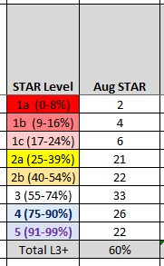
Baseline Data-Grade 01
STAR RDG STARMath MATH

Slide 11
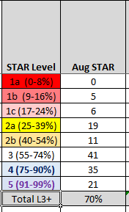
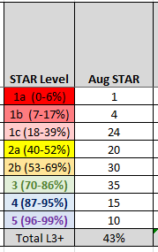
Baseline Data-Grade 02
STAR RDG STAR MATH

Slide 12
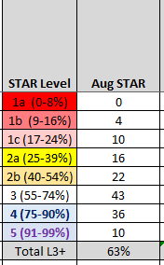
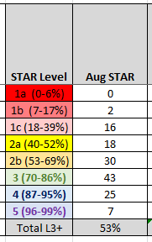
Baseline Data-Grade 03
STAR RDG STAR MATH

Slide 13
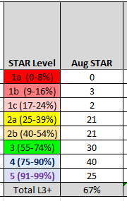
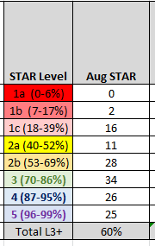
Baseline Data-Grade 04
STAR RDG STAR MATH

Slide 14
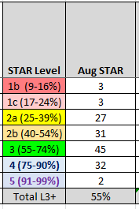
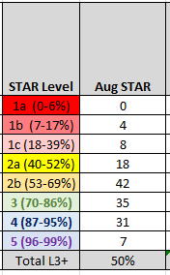
Baseline Data-Grade 05
STAR RDG STAR MATH

Slide 15
Implementation Plan
Purchase and Provide Professional Development for:
STAR Custom
Accelerated Math
Instructional Coaching:
Understanding the STAR test “buckets” or sub groups
Understanding how to use STAR Instructional Plans

Slide 16
Implementation Plan
Mastery/Enrichment (ME) Time
40 minutes every day
To immediately remediate (as needed) standards taught that day or during the week
To provide creative/enrichment time for students who have mastered the standards
All students will be provided instruction or skills practice from their STAR Instructional Plan
Progress Monitoring
Data Chats with teachers and students

Slide 17
Implementation Plan
Lowest 25%
Cooperative Classrooms
Resource Teacher
Paraprofessional
ME Time
Special Area Teachers push in

